Slide 1
Name services and Domain Name Systems

Slide 2
A name service stores information about a collection of textual names, in the form of bindings between the names and the attributes of the entities such as users, computers, services and objects.
The collection is often subdivided into one or more naming contexts ( individual subsets of the bindings that are managed as a unit).
The major operation that a name service supports is to resolve a name – that is, to look up attributes from a given name

Slide 3
A name space is the collection of all valid names recognized by a particular service.
The service will attempt to look up a valid name .
Name spaces require a syntactic definition to separate valid names from invalid names.
For example, ‘...’ is not acceptable as the DNS name of a computer, whereas www.cdk99.net is valid

Slide 4
DNS
DNS names are strings called domain names.
Some examples are www.cdk5.net ,net, com and ac.uk
The DNS name space has a hierarchic structure: a domain name consists of one or more strings called name components or labels, separated by the delimiter ‘.’.
There is no delimiter at the beginning or end of a domain name, although the root of the DNS name space is sometimes referred to as ‘.’ for administrative purpose.

Slide 5
Alias
An alias is a name defined to denote the same information as another name.
Aliases allow more convenient names to be substituted for relatively complicated ones.
This allows alternative names to be used by different people for the same entity.

Slide 6
Name Resolution
For the common case of hierarchic name spaces, name resolution is an iterative or recursive process.
A name is repeatedly presented to naming contexts in order to look up the attributes to which it refers.
A naming context either maps a given name onto a set of primitive attributes (such as those of a user) directly.
Or maps it onto a further naming context and a derived name to be presented to that context.

Slide 7
To resolve a name, it is first presented to some initial naming context; resolution iterates as long as further contexts and derived names are output.

Slide 8
Name servers and navigation
Any name service, such as DNS, that stores a very large database and is used by a large population will not store all of its naming information on a single server computer.
DNS specifies that each subset of its database is replicated in at least two failure-independent servers.

Slide 9
We mentioned above that the data belonging to a naming domain is usually stored by a local name server managed by the authority responsible for that domain.
Although, in some cases, a name server may store data for more than one domain, it is generally true to say that data is partitioned into servers according to its domain.

Slide 10
The process of locating naming data from more than one name server in order to resolve a name is called navigation.
The client name resolution software carries out navigation on behalf of the client.
It communicates with name servers as necessary to resolve a name.

Slide 11
One navigation model that DNS supports is known as iterative navigation .
To resolve a name, a client presents the name to the local name server, which attempts to resolve it.
If the local name server has the name, it returns the result immediately.
If it does not, it will suggest another server that will be able to help.
Resolution proceeds at the new server, with further navigation as necessary until the name is located or is discovered to be unbound.

Slide 12
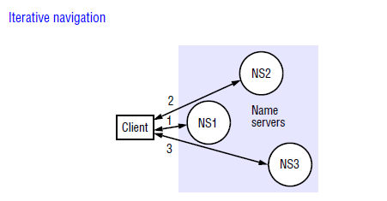

Slide 13
In multicast navigation, a client multicasts the name to be resolved and the required object type to the group of name servers.
Only the server that holds the named attributes responds to the request

Slide 14
non-recursive server controlled navigation
Any name server may be chosen by the client.
This server communicates by multicast or iteratively with its peers

Slide 15
recursive server-controlled navigation
The client once more contacts a single server.
If this server does not store the name, the server contacts a peer storing a (larger) prefix of the name, which in turn attempts to resolve it.
This procedure continues recursively until the name is resolved

Slide 16
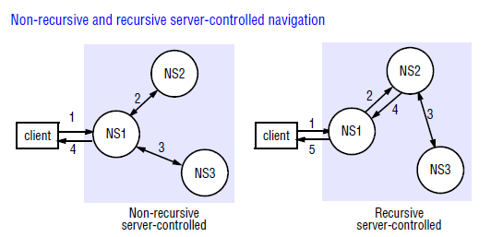

Slide 17
Caching
In DNS and other name services, client name resolution software and servers maintain a cache of the results of previous name resolutions.
When a client requests a name lookup, the name resolution software consults its cache.
If it holds a recent result from a previous lookup for the name, it returns it to the client;
otherwise, it sets about finding it from a server. That server, in turn, may return data cached from other servers.

